Slide 1

Diabetics prediction and cause analysis in U.S.
Akshay Puthanmari Murali
Sravya Arutla
Shwetha Panampilly

Slide 2
Agenda
Overview
Motivation and Project overview.
Preprocessing
Dataset’s Preprocessing and cleansing
Processing
Applying Various ML techniques to achieve the Output
Result and Analysis
Interesting Finds.
Results .
Reference and Outro
Reference we took.
And Conclusion

Slide 3
Motivation and Project Overview
Diabetics is the 7th leading cause of Death in US ( cdc.gov)
#1 for kidney failure , lower-limb amputation and adult blindness.
Past 20 years the Number of Adults diagnosed has more than doubled.
We came up with the analysis of more than 20+ factors (dataset ) to analysis and Predict Diabetics.

Slide 4
Preprocessing
Data Collection : Released by CDC and can be found here and also Kaggle.
Data Cleansing ( Null value , Duplicates , Outliers removal : Future Work)

Slide 5
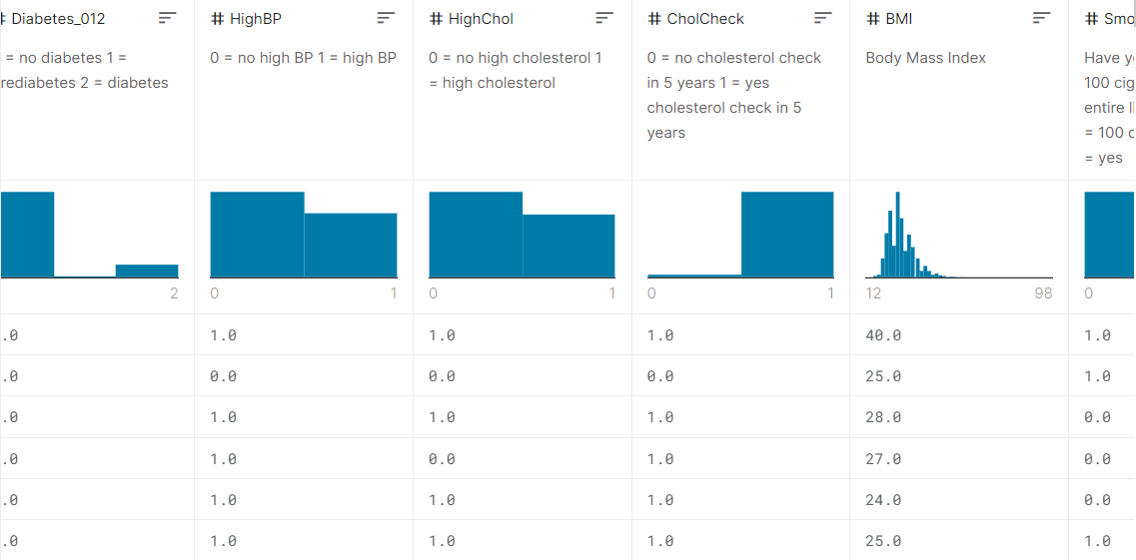
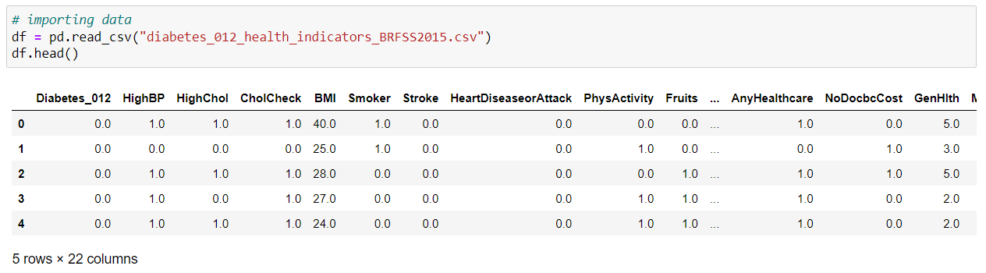
Picture Talk
Fig 1.1 : Snippet of Kaggle Dataset
Fig 1.2 : Snippet of Jupyter Notebook import

Slide 6
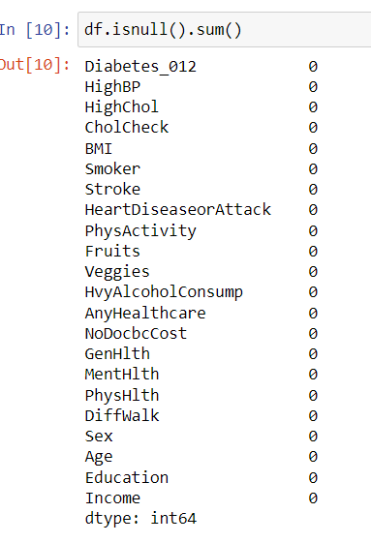
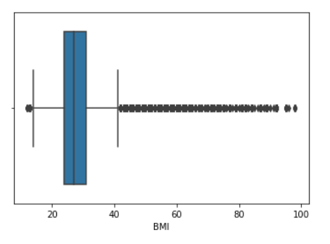
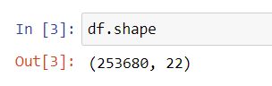
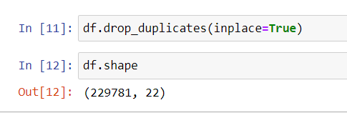
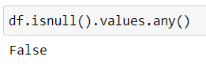
Fig : 1.3 : Original Data set
Fig 1.6 : Outliers for BMI on sub plot. BMI with 60+ is highly impossible.
Fig 1.4 : Dataset after dropping the duplicates
Fig 1.5 : Null values sum after preprocessing
Fig 1.7 : No null values after processing

Slide 7
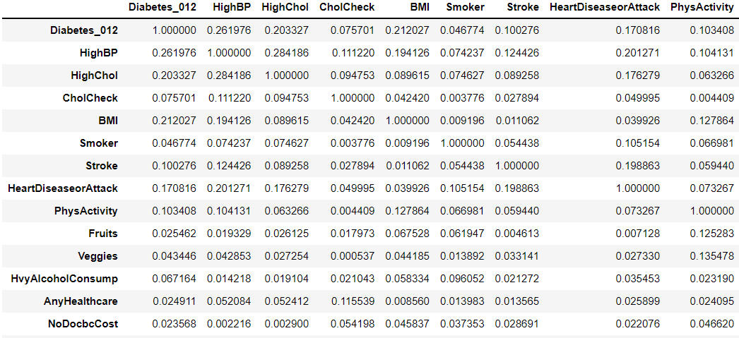
Dimensionality Reduction and Curse of Dimensionality
We followed 2 approach to reduce the Dimensionality and fight the curse of Dimensionality
Co-Relation
Forward Selection
Fig 1.8: Correlation Confusion Matrix

Slide 8
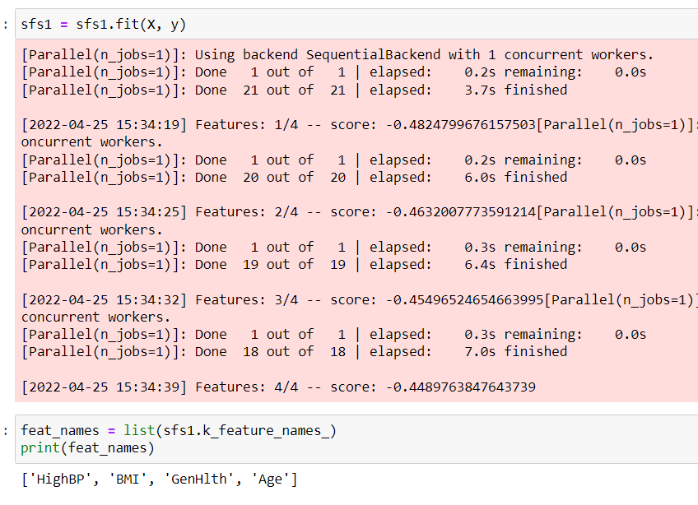
Fig 1.9 Forward Feature Selection

Slide 9

Processing
Decision Tree and it’s effectiveness.
Multinomial Logistic Regression.
Neural Networks – ( Yet to be implemented, Can be an add-on )

Slide 10

Decision Trees

Slide 11
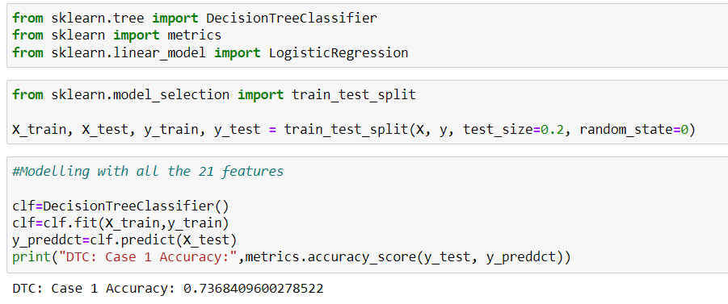

Slide 12
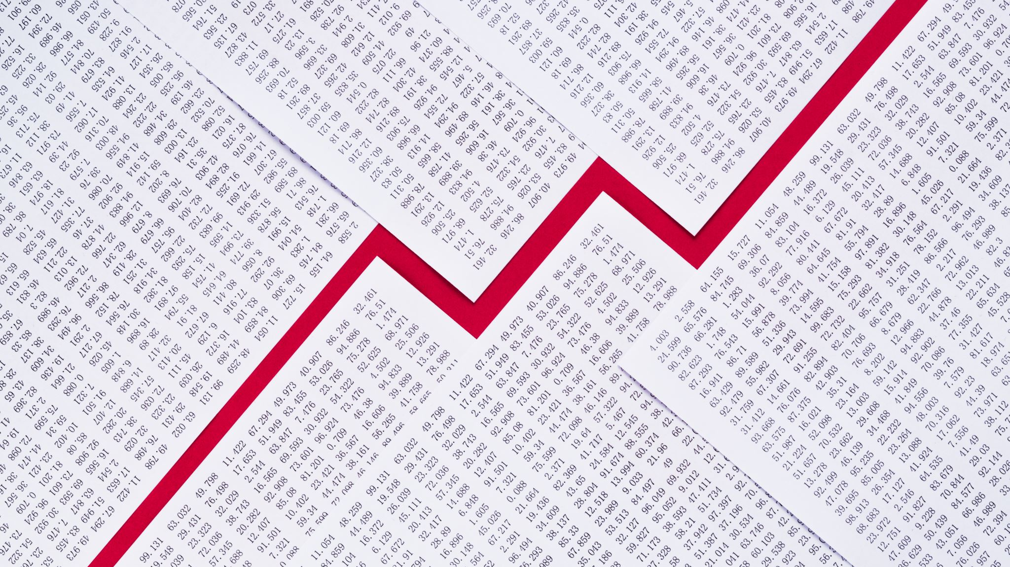
Multinomial Logistic Regression

Slide 13
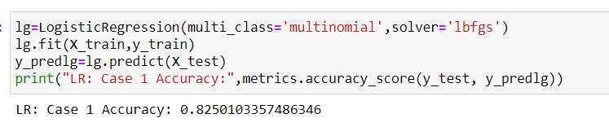

Slide 14

Results and Analysis.
Interesting finds.
Prediction Accuracy.
Final Thoughts

Slide 15
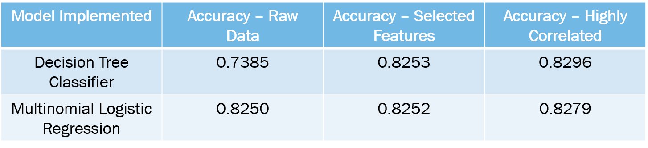
Accuracy

Slide 16

Interesting Finds
Only 15% were diabetic (35K) and 3% prediabetics(4.5K) out of the 229k data.
Females → 128 K || 19,200 (diabetics) || 3,800 (Prediabetic)
Males → 100 K || 15,000(diabetics)|| 3,000(prediabetic)
High Blood Pressure , BMI , General Health , High Cholesterol level and Age are the most affecting order.
Education and High Blood Pressure have correlations
Income and Heart Attack has correlations
Difficulty in walking and General Health is having correlation.

Slide 17

Future Works
Outliers Removal
Neural Networks ( It is going to be an Add On).

Slide 18

The End!

Slide 19

Thanks !

